Slide 1

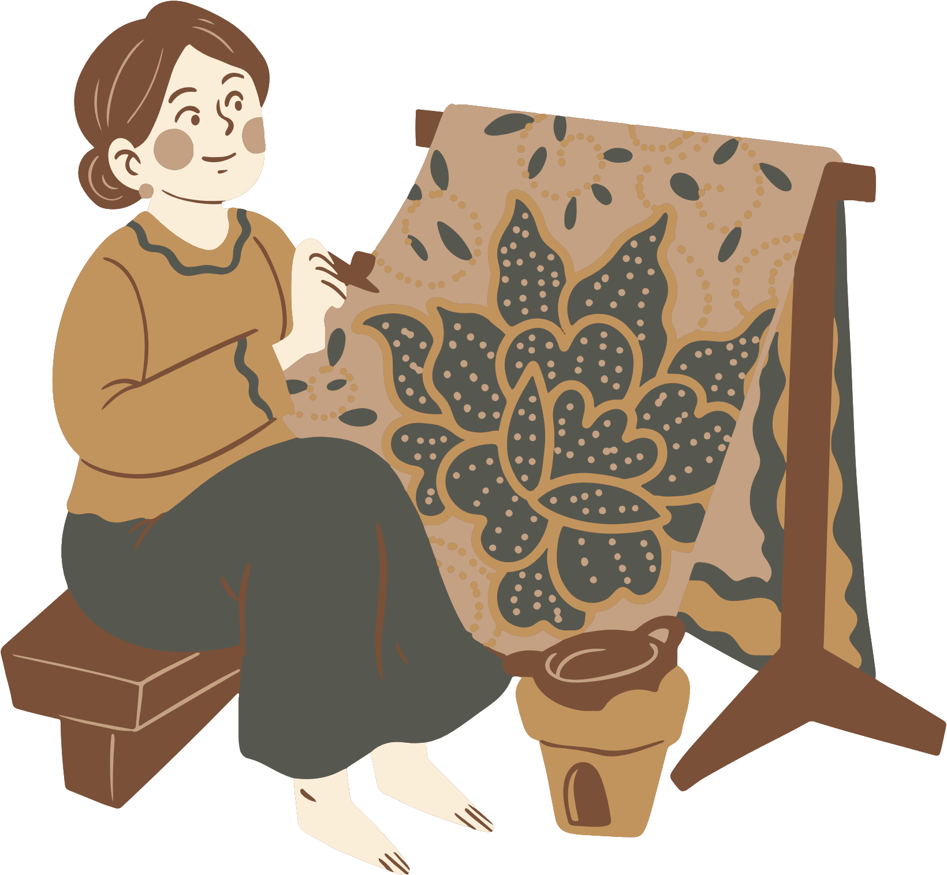

ArtConnect India
Uniting Culture Through E-Commerce
Team “Dragon”
Danda Vamsi Chakradhar
Machiraju Karthikeya Manjunadha
Vennampalli Venkateswarlu
M Santosh Reddy
Puvvada Vamsidhar

Slide 2

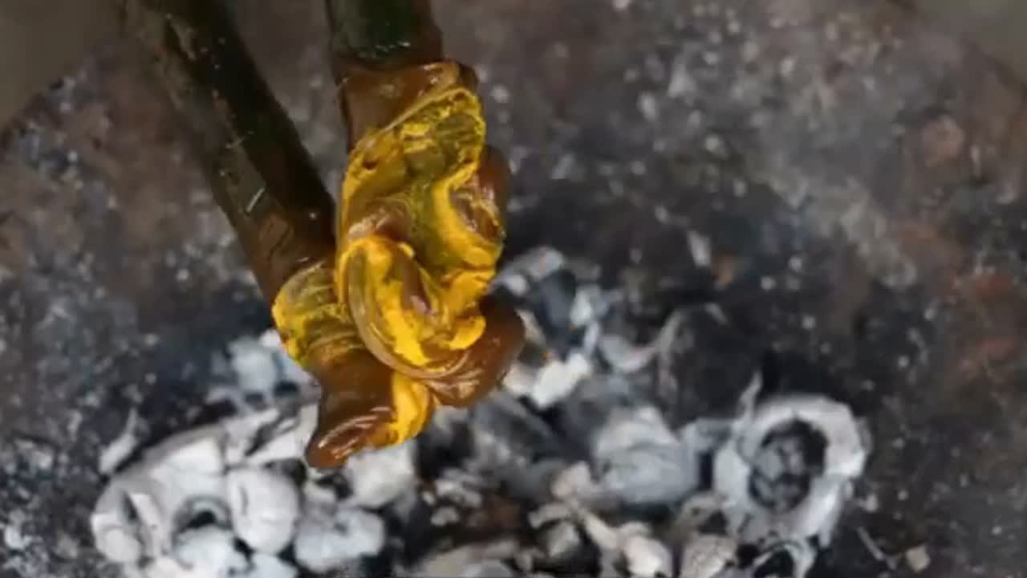
Documentary on Declining Traditional Arts in India

Slide 3
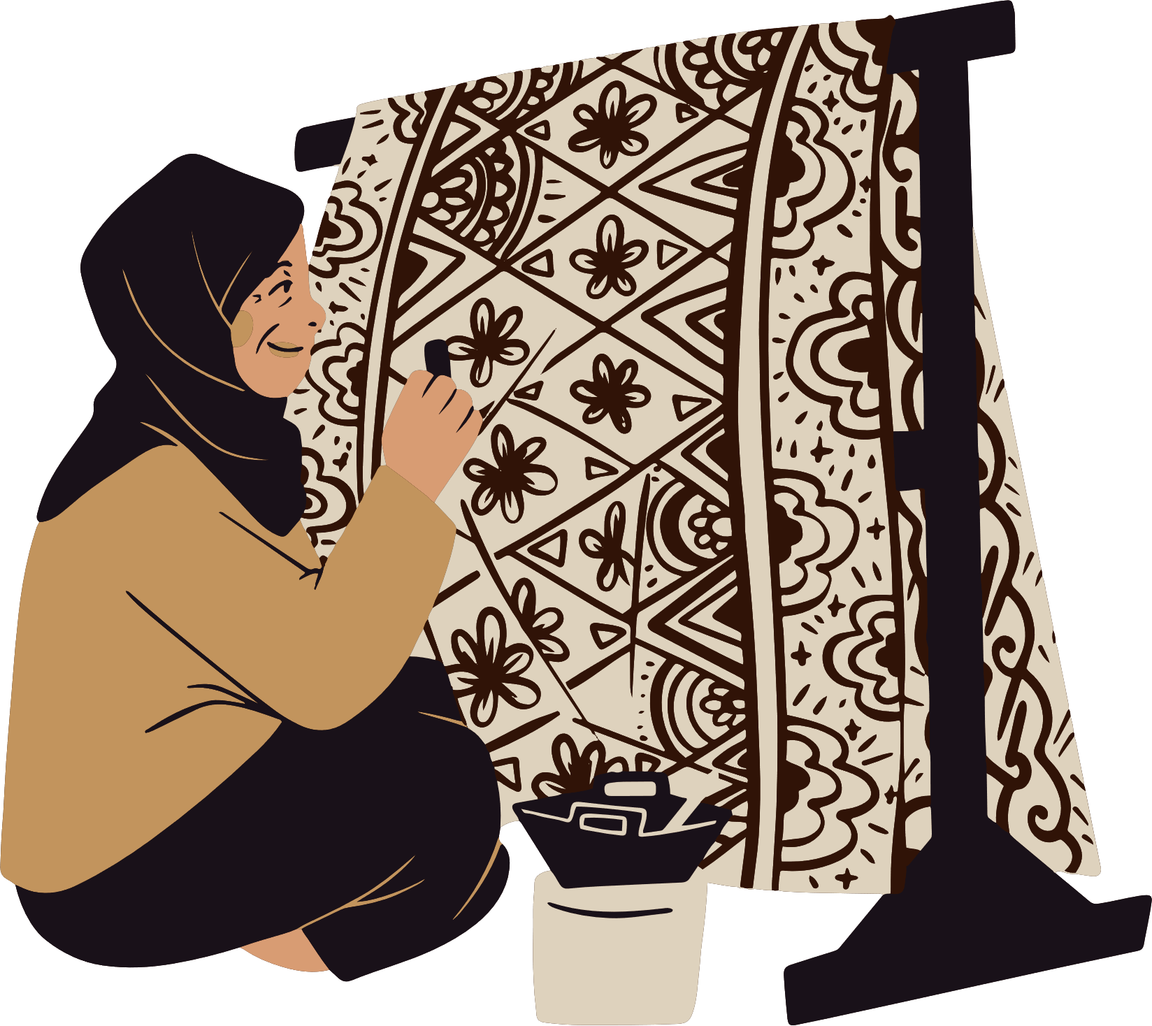
Introduction
India is home to a rich and diverse tradition of handicrafts, each reflecting the unique culture of different regions. From Pashmina weaving in Kashmir to Madhubani paintings in Bihar, these art forms are more than just crafts – they are a legacy passed down through generations. However, with the rise of mass production, e-commerce giants, and changing consumer preferences, these traditional art forms are struggling to survive.
Problem Statement
India's traditional handicrafts are struggling as artisans face low demand, unfair earnings, and limited digital reach. Middlemen take a significant share of profits, while mass-produced imitations make it harder for consumers to find authentic crafts. With financial insecurity and fewer opportunities, younger generations are moving away from these trades, putting many traditional art forms at risk of extinction and leading to a major loss of cultural heritage.

Slide 4
Uniqueness of Our Idea
Aggregator Model
Unlike individual artisan platforms, you partner with local websites, making it scalable.
Transparency with QR Codes
Customers scans QR code on each product to see the artist’s name, price paid, and creation date.
No Inventory Handling
The platform operates as a middleman, ensuring lower operational costs.
Cultural Storytelling
Each product page will feature the history, artisan profile, and making process of the art form.
State-Based Promotions
Partnered websites can run regional promotions, increasing sales of local art.

Slide 5


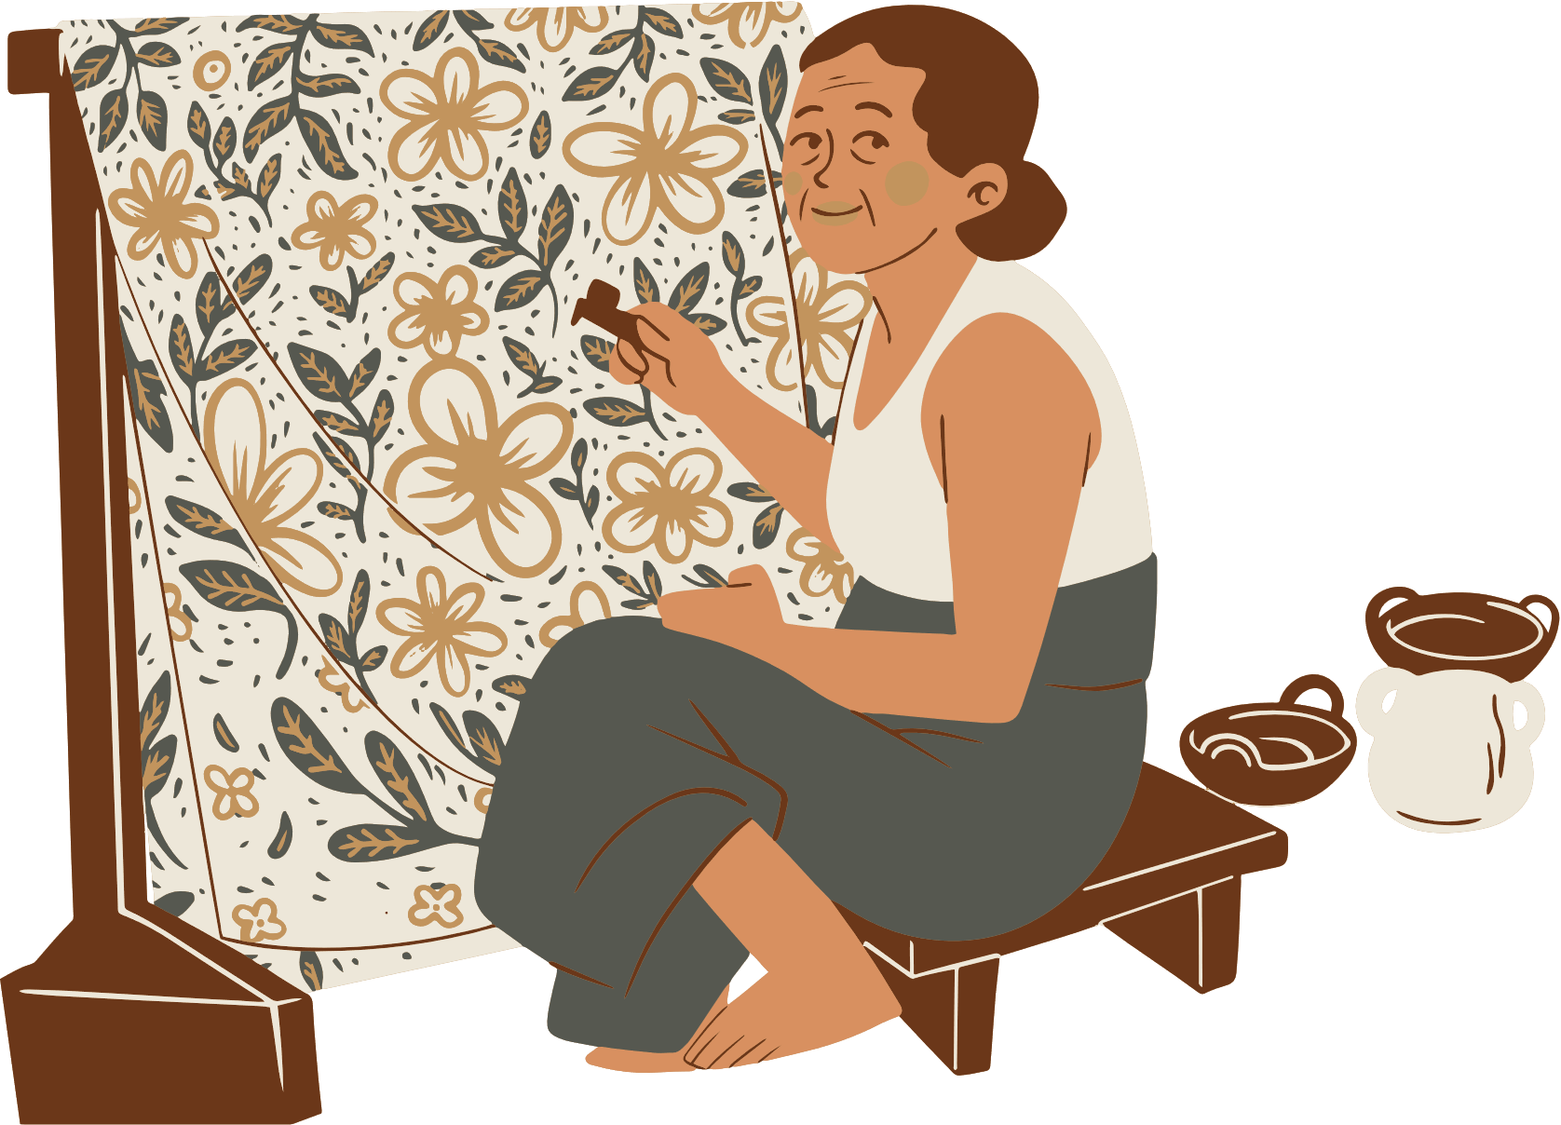
Importance of Our Idea
Preserving Cultural Heritage
Empowering Local Artisans
Bridging the Digital Gap .
Enhancing Transparency
Boosting Economic Growth
Impact on Society
Increased Sales & Visibility
Fair & Direct Earnings
Consumer Trust & Engagement
Encouraging Future Generations
Sustainable & Ethical Business

Slide 6


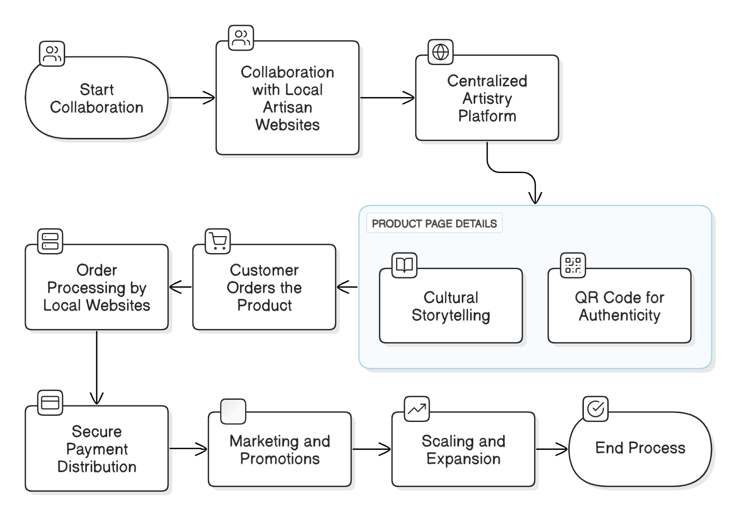
Workflow
Step 1: Collaboration with Local Artisan Websites
Step 2: Centralized Artistry Platform
Each product page includes:
Cultural storytelling to engage buyers.
QR Code ensuring authenticity, artisan details, and pricing transparency.
Step 3: Customer Orders the Product
Step 4: Order Processing by Local Websites
Step 5: Secure Payment Distribution
Step 6: Marketing & Promotions
Step 7: Scaling & Expansion

Slide 7
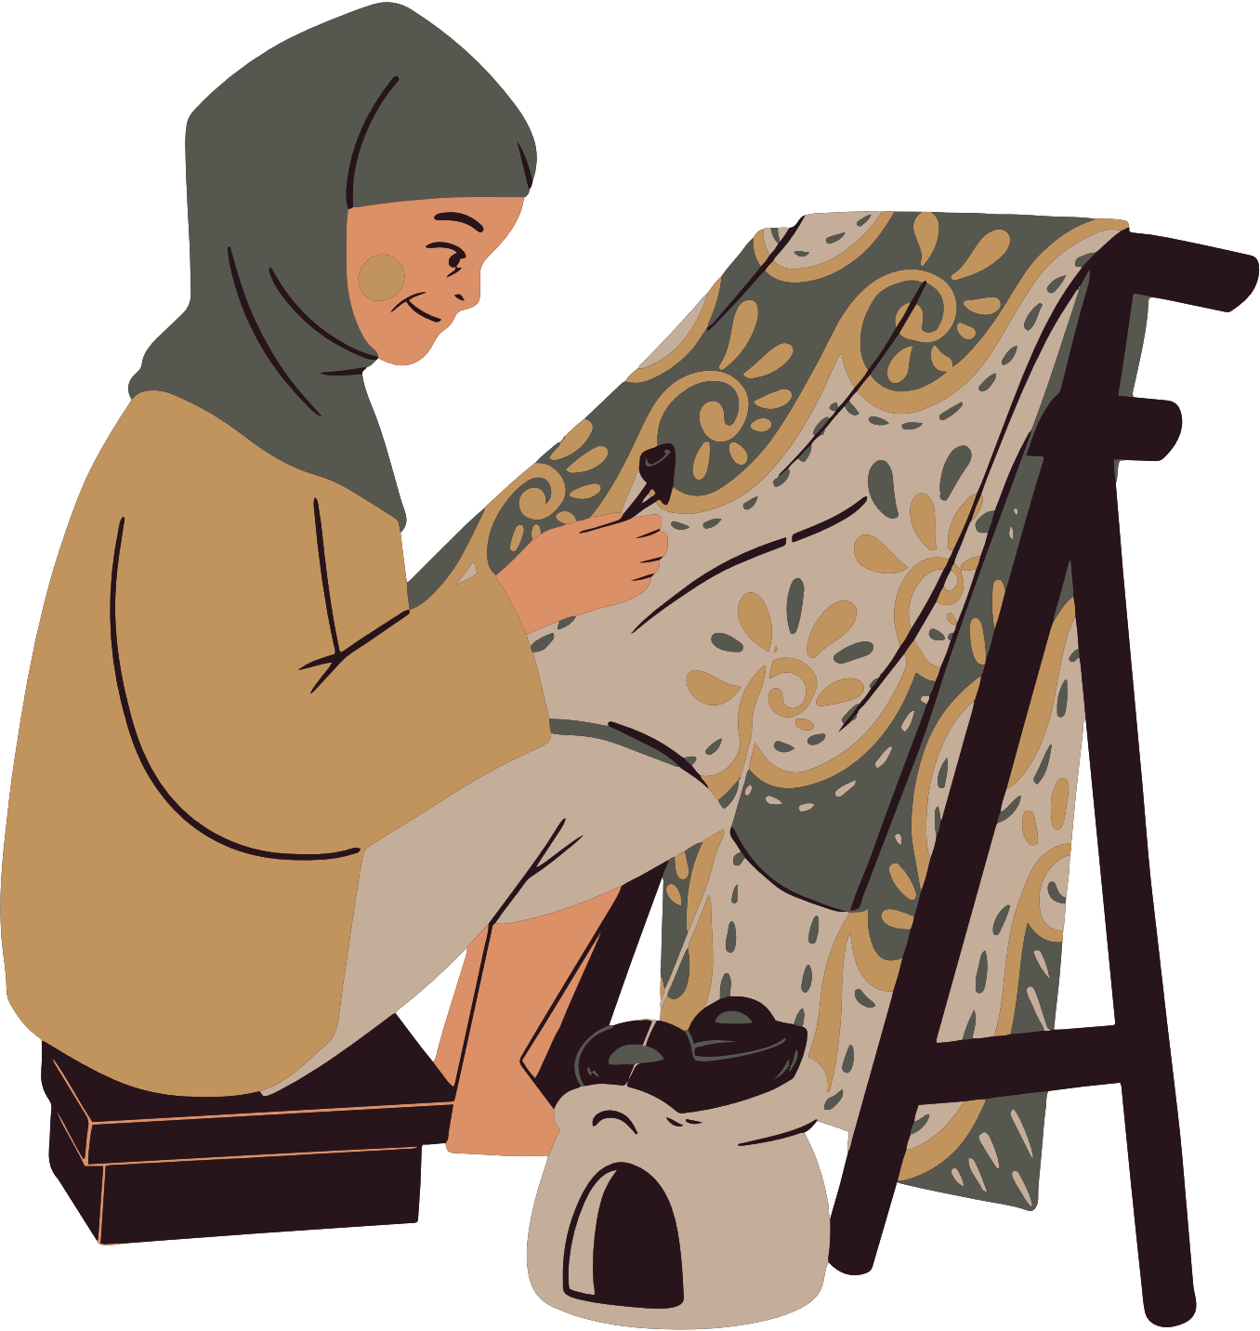
Feasibility and Scalability
Growing Market for Handmade Products – The Indian handicraft market is expected to grow at 10% CAGR due to increasing demand.
Low Operational Costs – No need to manage warehouses or logistics, reducing overhead costs.
Tech Integration Possible – SAP Commerce Cloud, Shopify, or custom development can support the aggregator model.
Government Support – Initiatives like Make in India, TRIFED, and ODOP (One District One Product) can help in artisan onboarding.
Expand Partnerships – Onboard more local websites across states.
AI & Mobile App – Smart recommendations & better accessibility.
Global Reach – Enable international shipping.
Festival & Influencer Marketing – Boost sales through seasonal & social media campaigns.

Slide 8
Competitive Analysis
Feature | Our Platform | Craftsvilla | Amazon Karigar | India Craft House
Aggregator Model | Partners with local sites | Own inventory | Direct Sales model | Direct Artisan sales
Transparency (QR Code) | Yes | No | No | No
Cultural Storytelling | Yes | Limited | Limited | Yes
State Wise Promotions | Yes | No | No | No
Global Reach | Yes | Yes | Yes | Yes
Fair Artisan Payment | Directly Visible to customers | Indirect | Indirect | Direct but no Transparency

Slide 9
Business Model
Component | Details
Value Proposition | A one-stop marketplace for Indian traditional art, ensuring authenticity, transparency, and fair artisan compensation.
Customer Segments | Art enthusiasts, collectors, home decorators, NRIs, tourists, and people looking for ethnic gifts.
Key Partners | Local artisan websites, cultural organizations, logistics providers, government handicraft initiatives (TRIFED, KVIC, etc.).
Revenue Streams | Platform commission (10-20%), promotional fees from vendors, premium artisan features, corporate gifting services.
Key Activities | Platform development, artist verification, marketing, partnership expansion, order tracking integration.
Cost Structure | Website maintenance, marketing, customer support, partner onboarding.

Slide 10


